Slide 1

CSCI 476: Computer Security
Lecture 3: Operating Systems Review
Reese Pearsall
Fall 2022
*all images are stolen from the internet
https://www.cs.montana.edu/pearsall/classes/fall2022/476/main.html

Slide 2
Announcements
TA
Karishma Rahman
karishma.rahman.bd@gmail.com
Office Hours: Tuesdays 1:00 pm to 3:00 pm
Location: Barnard 259
Lab 0 due tonight at 11:59 PM
Lectures are all recorded
Raytheon cyber security talk tonight @ 5PM in Barnard Hall 347

Slide 3
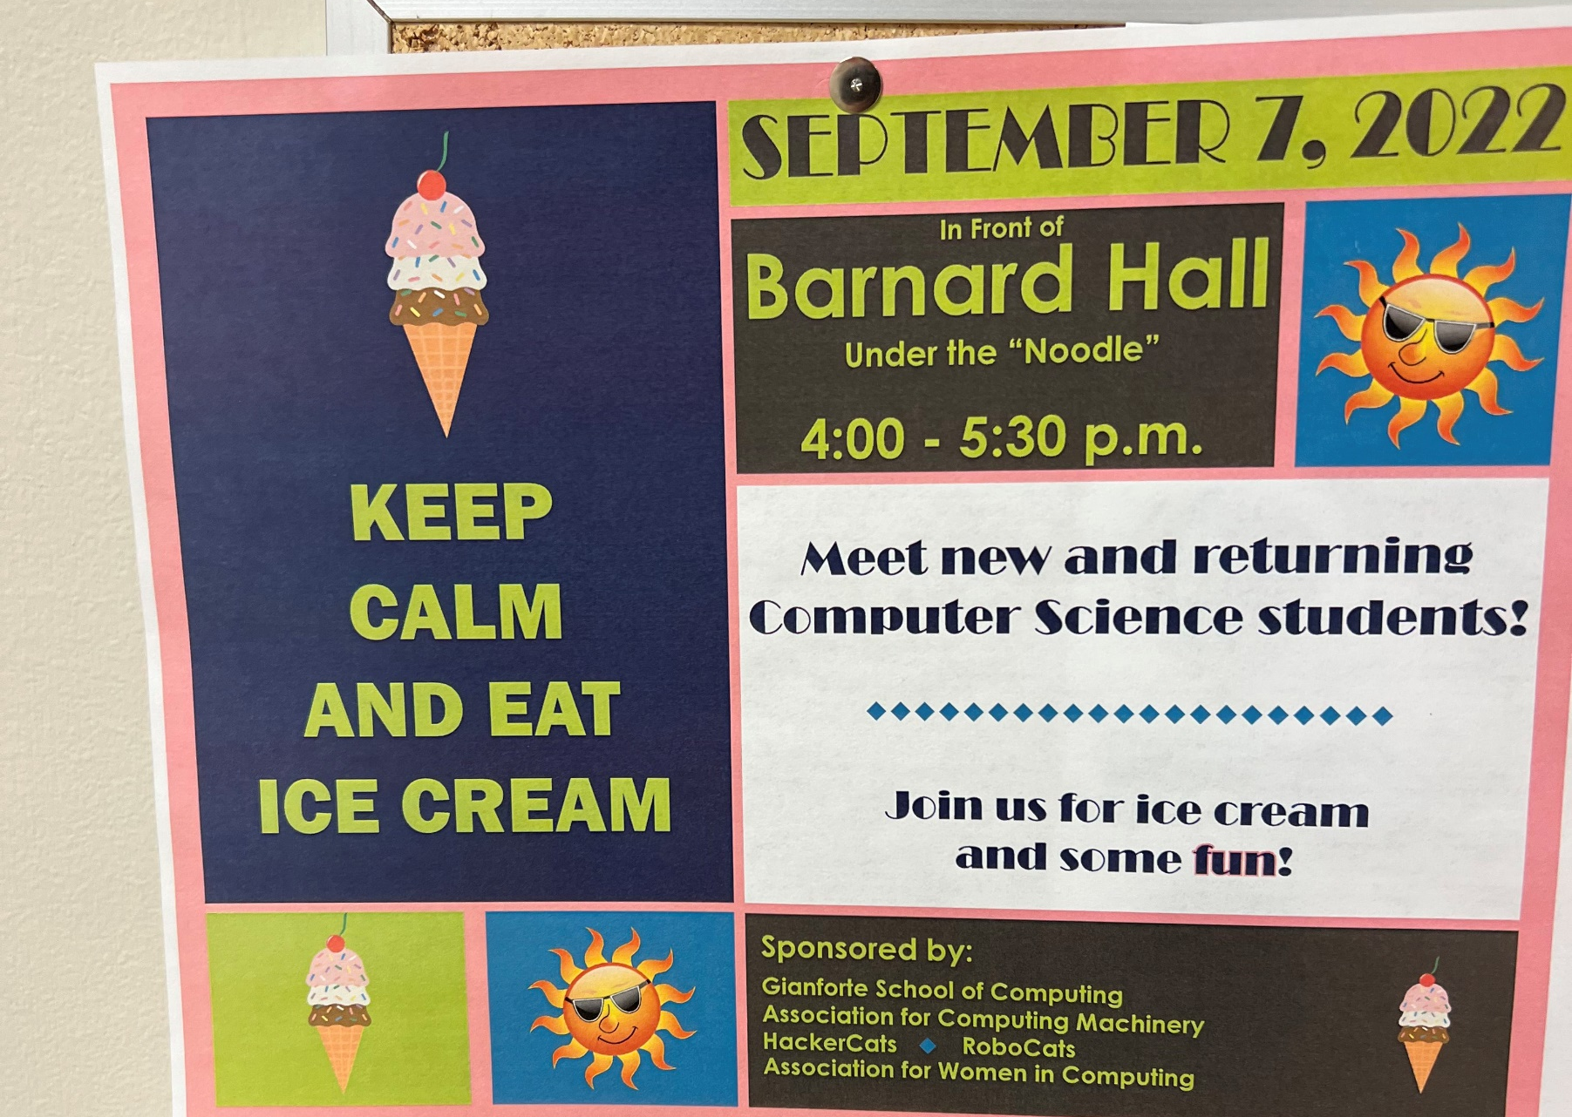
Announcements

Slide 4

Operating Systems Review
To understand the technical aspects of security, we must have a good understanding of how computers work
operating systems

Slide 5

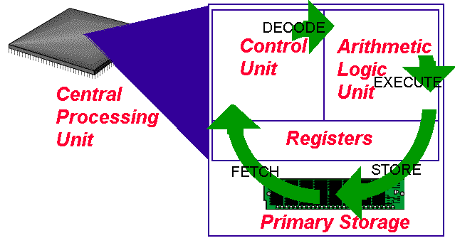
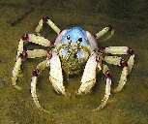
Operating Systems Review
Software
print(“hello world!”)
Operating System
Hardware
CPU
Memory

Slide 6
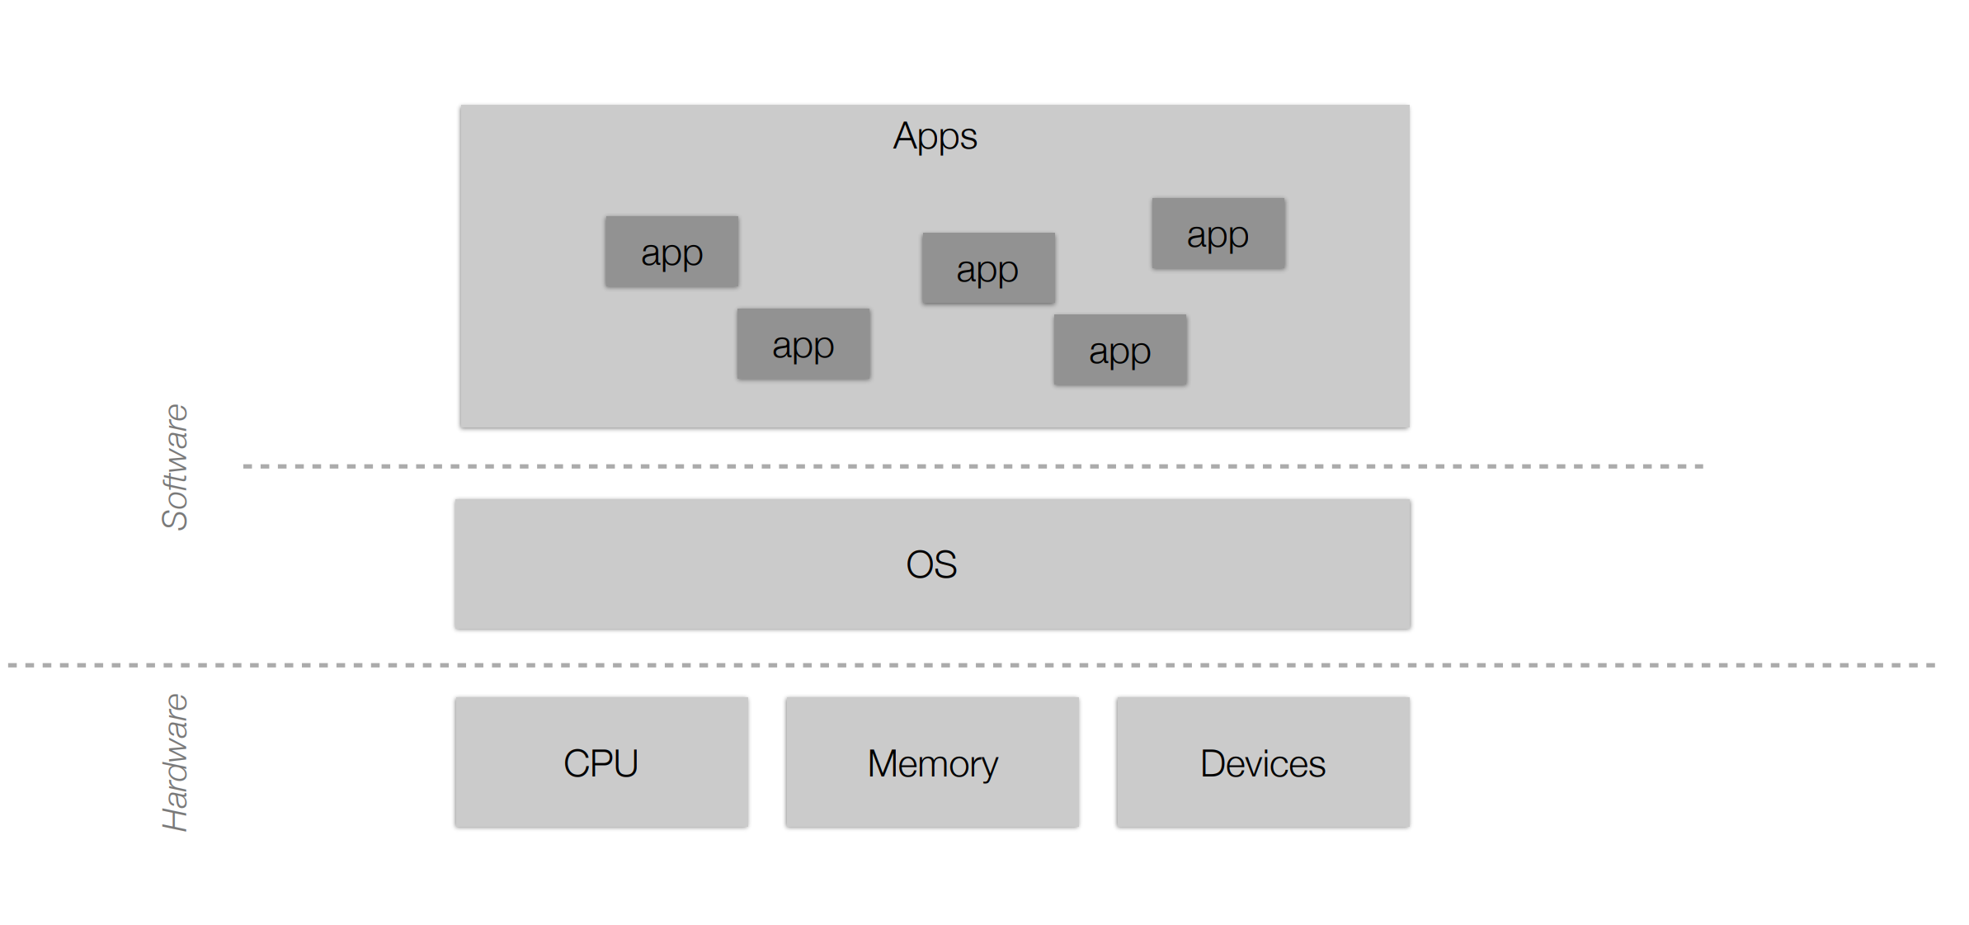
Operating Systems Review

Slide 7



Operating Systems Review
Responsibilities of the OS?
Interface Manager
Manages communication between apps and hardware

Slide 8

Operating Systems Review
Responsibilities of the OS?
Interface Manager
Manages communication between apps and hardware
Process Manager
Manages how processes are structured and how to handle many processes running at once

Slide 9

Operating Systems Review
Responsibilities of the OS?
Interface Manager
Manages communication between apps and hardware
Process Manager
Manages how processes are structured and how to handle many processes running at once
Traffic Manager
Manages which programs should be executed by the CPU

Slide 10

Operating Systems Review
Responsibilities of the OS?
Interface Manager
Manages communication between apps and hardware
Process Manager
Manages how processes are structured and how to handle many processes running at once
Traffic Manager
Manages which programs should be executed by the CPU
Memory Manager
Manages how physical memory is utilized

Slide 11

Operating Systems Review
Responsibilities of the OS?
Interface Manager
Manages communication between apps and hardware
Process Manager
Manages how processes are structured and how to handle many processes running at once
Traffic Manager
Manages which programs should be executed by the CPU
Memory Manager
Manages how physical memory is utilized

Slide 12




Operating Systems Review
Responsibilities of the OS?
Interface Manager
Manages communication between apps and hardware
How does an application get access to a computer's resources?

Slide 13
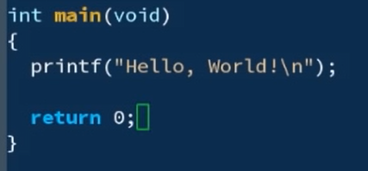
Syscalls
Applications evoke operating system defined functions, or system calls (syscalls), to access computing resources

Slide 14
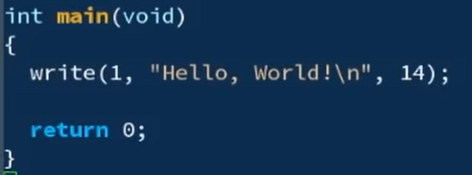
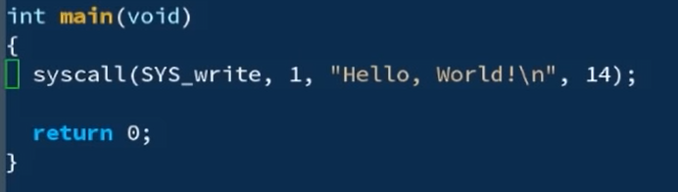
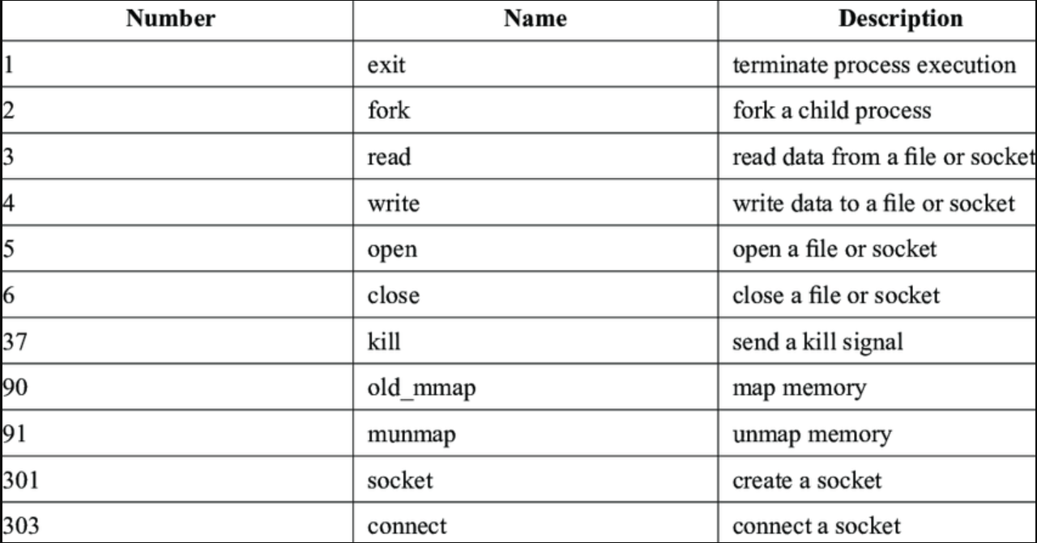
Syscalls
Applications evoke operating system defined functions, or system calls (syscalls), to access computing resources

Slide 15
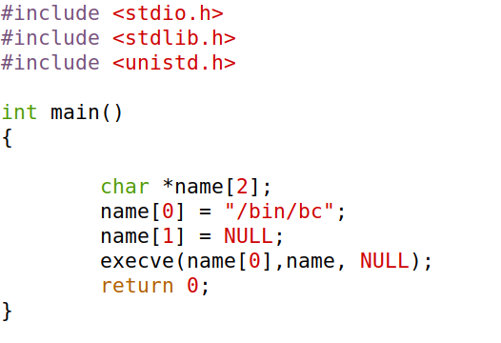
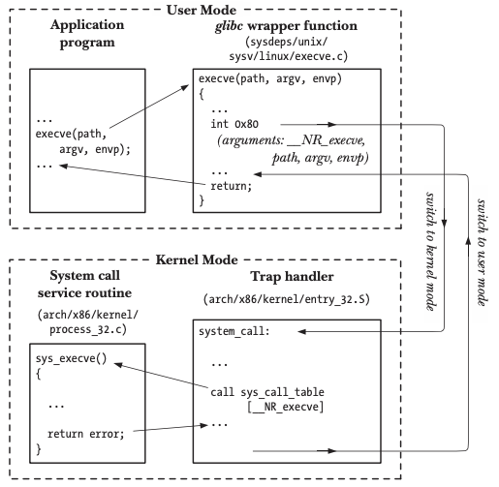
Syscalls
Applications evoke operating system defined functions, or system calls (syscalls), to access computing resources
syscall

Slide 16
Syscalls
Applications evoke operating system defined functions, or system calls (syscalls), to access computing resources
Libraries handle the system calls for us
syscall

Slide 17
Syscalls
Applications evoke operating system defined functions, or system calls (syscalls), to access computing resources
Libraries handle the system calls for us
syscall
The operating system have hundreds of different syscalls, and different syscalls have different parameters, we need a way to distinguish them
EAX
EBX
ECX
EDX

Slide 18
Syscalls
Applications evoke operating system defined functions, or system calls (syscalls), to access computing resources
Libraries handle the system calls for us
syscall
The operating system have hundreds of different syscalls, and different syscalls have different parameters, we need a way to distinguish them
EAX
System Call Number
EBX
Address of “/bin/bc”
ECX
0 or 1
Environment variables
The OS will look at the values at certain registers!
EDX
INT 0x80
send trap to kernel and invoke the syscall

Slide 19
Syscalls
Applications evoke operating system defined functions, or system calls (syscalls), to access computing resources
Libraries handle the system calls for us
syscall
EAX
System Call Number
EBX
Address of “/bin/bc”
ECX
0 or 1
Environment variables
EDX
INT 0x80
send trap to kernel and invoke the syscall

Slide 20
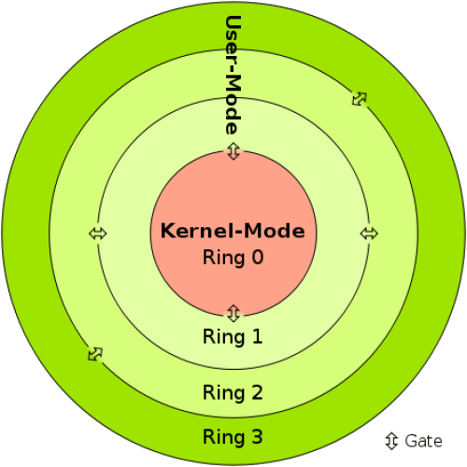
Syscalls
All applications run in user mode.
The code has no ability to directly access hardware
Code running in user mode must use API/syscalls to access hardware and memory

Slide 21
Syscalls
All applications run in user mode.
The code has no ability to directly access hardware
Code running in user mode must use API/syscalls to access hardware and memory
Code running in kernel-mode has complete, unrestricted access to computer resources
Reserved for the lowest-level trusted functions of the operating system

Slide 22
Syscalls
The collective functionality and services of the OS that manages the computer and its resources is called the kernel

Slide 23
Syscalls
Applications evoke operating system defined functions, or system calls (syscalls), to access computing resources
Libraries handle the system calls for us
syscall
EAX
System Call Number
EBX
Address of “/bin/bc”
ECX
0 or 1
Environment variables
EDX
INT 0x80
send trap to kernel and invoke the syscall

Slide 24

Syscalls
Applications evoke operating system defined functions, or system calls (syscalls), to access computing resources
Libraries handle the system calls for us
syscall
EAX
System Call Number
EBX
Address of “/bin/bc”
ECX
0 or 1
Environment variables
EDX
INT 0x80
send trap to kernel and invoke the syscall

Slide 25
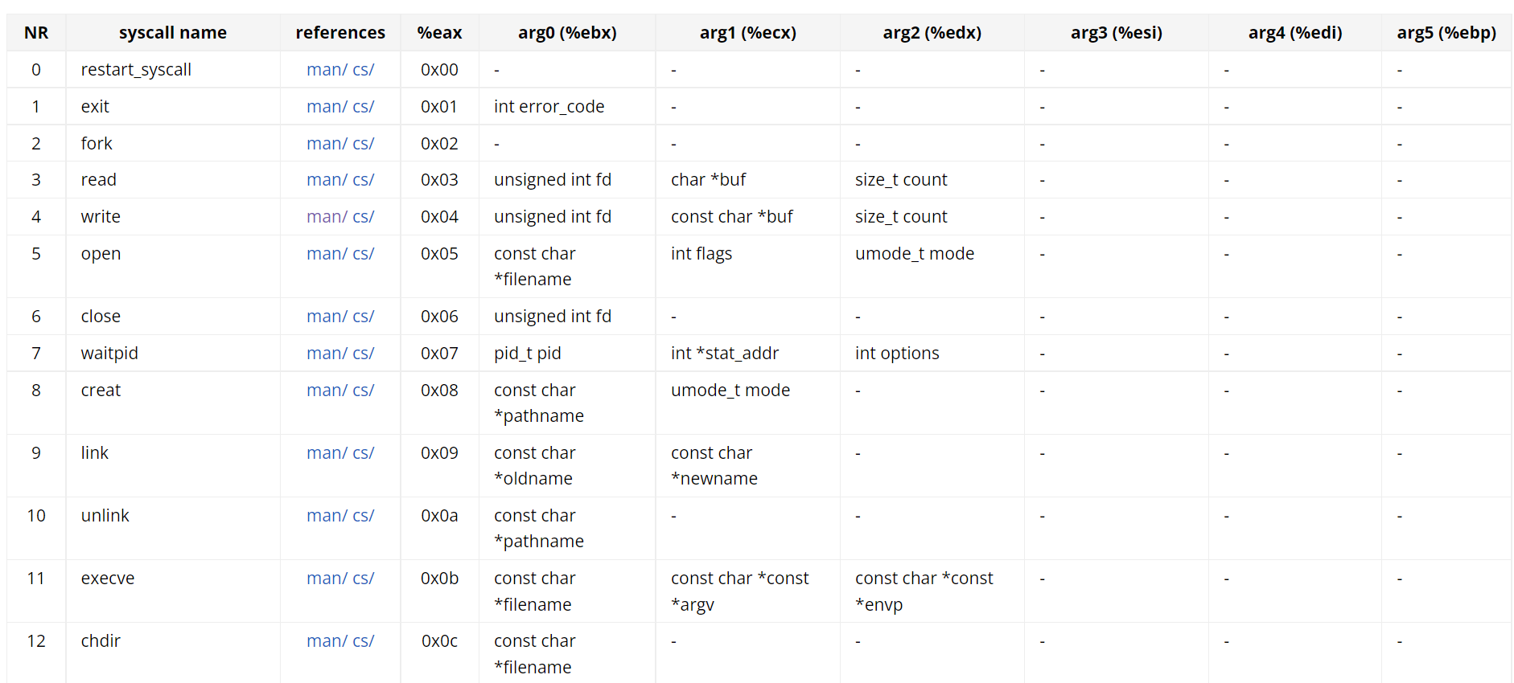

Syscalls
Applications evoke operating system defined functions, or system calls (syscalls), to access computing resources
Libraries handle the system calls for us
syscall
EAX
System Call Number
EBX
Address of “/bin/bc”
ECX
0 or 1
Environment variables
EDX
INT 0x80
send trap to kernel and invoke the syscall

Slide 26
Syscalls
Applications evoke operating system defined functions, or system calls (syscalls), to access computing resources
Libraries handle the system calls for us
https://chromium.googlesource.com/chromiumos/docs/+/master/constants/syscalls.md#x86-32_bit
syscall
EAX
System Call Number
EBX
Address of “/bin/bc”
ECX
0 or 1
Environment variables
EDX
INT 0x80
send trap to kernel and invoke the syscall

Slide 27
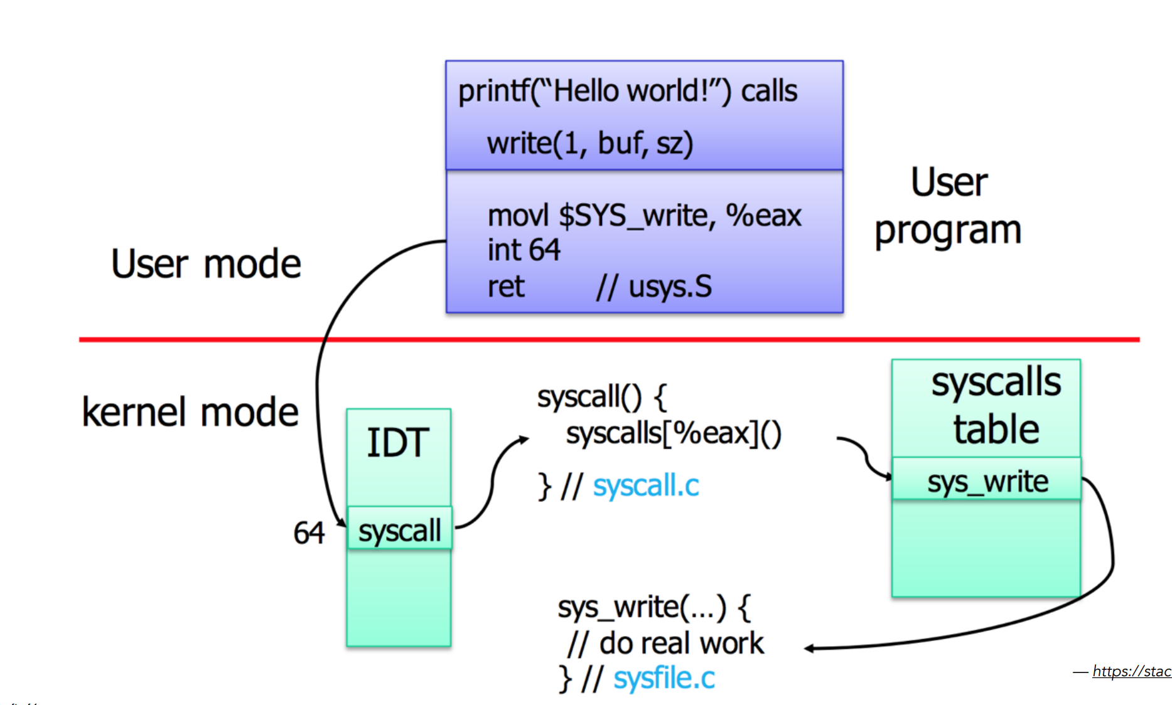
Syscalls

Slide 28





Applications Layout in Memory
Process Manager
Manages how processes are structured and how to handle many processes running at once
How does a program get loaded into memory?

Slide 29





Applications Layout in Memory
Process Manager
Manages how processes are structured and how to handle many processes running at once
How does a program get loaded into memory?
An active program running on a computer is called a process

Slide 30
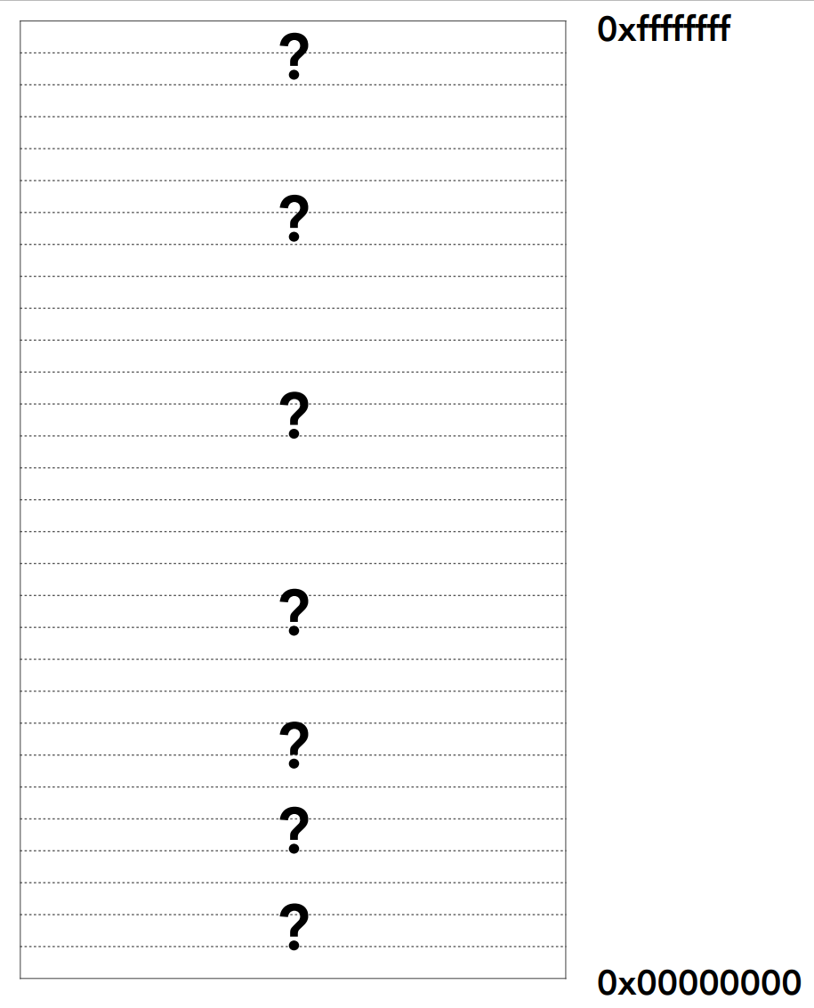

Applications Layout in Memory
Process Manager
Manages how processes are structured and how to handle many processes running at once
What does a program look like in memory?

Slide 31
Applications Layout in Memory
Process Manager
Manages how processes are structured and how to handle many processes running at once
0xFFFFFFFFFFFFFFFFFFFFFFFFF
Text
Executable instructions
Text Segment- binary executable instructions for the process
What does a program look like in memory?
0x00000000000000000000000

Slide 32
Applications Layout in Memory
Process Manager
Manages how processes are structured and how to handle many processes running at once
0xFFFFFFFFFFFFFFFFFFFFFFFFF
Data
Static variables with values
Text
Executable instructions
Data Segment- Static variables initialized by the programmer
What does a program look like in memory?
0x00000000000000000000000

Slide 33
Applications Layout in Memory
Process Manager
Manages how processes are structured and how to handle many processes running at once
0xFFFFFFFFFFFFFFFFFFFFFFFFF
BSS
Static variables without a value
Data
Static variables with values
Text
Executable instructions
BSS Segment- contains statically allocated variables that are declared, but have not been assigned a value yet
What does a program look like in memory?
0x00000000000000000000000

Slide 34
Applications Layout in Memory
Process Manager
Manages how processes are structured and how to handle many processes running at once
0xFFFFFFFFFFFFFFFFFFFFFFFFF
Heap
Space for dynamically allocated memory
BSS
Static variables without a value
Data
Static variables with values
Text
Executable instructions
Heap- memory set aside for dynamic allocation (e.g. malloc). Grows “up” as more memory is allocated
What does a program look like in memory?
0x00000000000000000000000

Slide 35
Applications Layout in Memory
Process Manager
Manages how processes are structured and how to handle many processes running at once
0xFFFFFFFFFFFFFFFFFFFFFFFFF
Stack
Space for function variables (temporary)
Heap
Space for dynamically allocated memory
BSS
Static variables without a value
Data
Static variables with values
Text
Executable instructions
Stack – memory for storing function variables. Grows “down” as additional functions are called
What does a program look like in memory?
0x00000000000000000000000

Slide 36
Applications Layout in Memory
Process Manager
Manages how processes are structured and how to handle many processes running at once
0xFFFFFFFFFFFFFFFFFFFFFFFFF
OS Kernel Space
Stack
Space for function variables (temporary)
Heap
Space for dynamically allocated memory
BSS
Static variables without a value
Data
Static variables with values
Text
Executable instructions
What does a program look like in memory?
0x00000000000000000000000

Slide 37
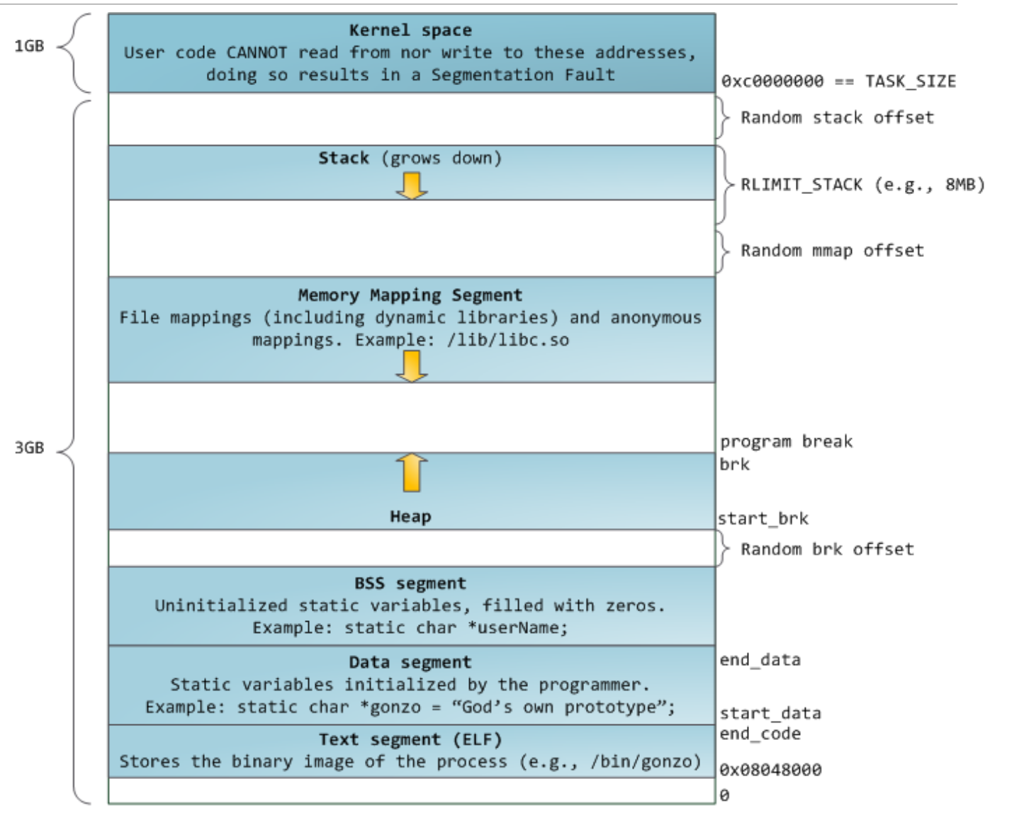
Applications Layout in Memory
Demo?

Slide 38
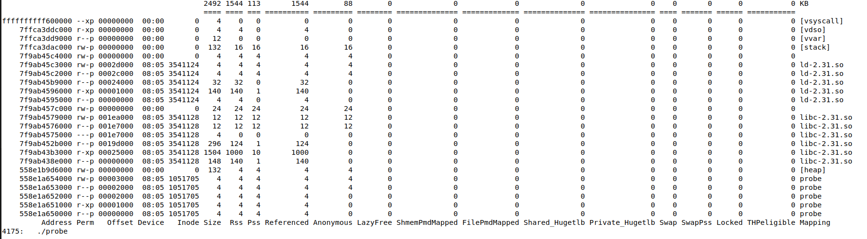
Applications Layout in Memory
Ouput of pmap (process mapping tool)

Slide 39
Applications Layout in Memory
Ouput of pmap (process mapping tool)
“probe” is the name of out executable

Slide 40
Applications Layout in Memory
Ouput of pmap (process mapping tool)
BSS
Static variables without a value
Data
Static variables with values
“probe” is the name of out executable
This section is executable “x”
Text
Executable instructions

Slide 41
Applications Layout in Memory
Ouput of pmap (process mapping tool)
Heap
Space for dynamically allocated memory
Beginning of heap
BSS
Static variables without a value
Data
Static variables with values
“probe” is the name of out executable
This section is executable “x”
Text
Executable instructions

Slide 42
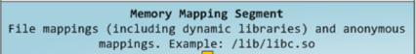
Applications Layout in Memory
Ouput of pmap (process mapping tool)
Heap
Space for dynamically allocated memory
Beginning of heap
BSS
Static variables without a value
Data
Static variables with values
“probe” is the name of out executable
This section is executable “x”
Text
Executable instructions

Slide 43
Applications Layout in Memory
Ouput of pmap (process mapping tool)
Stack
Space for function variables (temporary)
Beginning of stack
Heap
Space for dynamically allocated memory
Beginning of heap
BSS
Static variables without a value
Data
Static variables with values
“probe” is the name of out executable
This section is executable “x”
Text
Executable instructions

Slide 44
Applications Layout in Memory
Ouput of pmap (process mapping tool)
OS Kernel Space
Stack
Space for function variables (temporary)
Beginning of stack
Heap
Space for dynamically allocated memory
Beginning of heap
BSS
Static variables without a value
Data
Static variables with values
“probe” is the name of out executable
This section is executable “x”
Text
Executable instructions

Slide 45
Applications Layout in Memory
Ouput of pmap (process mapping tool)
OS Kernel Space
Stack
Space for function variables (temporary)
Heap
Space for dynamically allocated memory
BSS
Static variables without a value
Data
Static variables with values
Text
Executable instructions

Slide 46
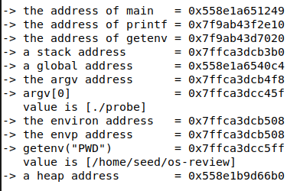
Applications Layout in Memory
Ouput of pmap (process mapping tool)

Slide 47
Applications Layout in Memory
Ouput of pmap (process mapping tool)
Where is “main” located in memory?

Slide 48


Applications Layout in Memory
Ouput of pmap (process mapping tool)
Where is “main” located in memory?
main is code in our program, so it goes inside the text segment

Slide 49
Applications Layout in Memory
Ouput of pmap (process mapping tool)
Where is “printf” located in memory?

Slide 50


Applications Layout in Memory
Ouput of pmap (process mapping tool)
Where is “printf” located in memory?
printf is executable code from a shared library (libc) so we are in the memory mapping segment!

Slide 51
Applications Layout in Memory
Ouput of pmap (process mapping tool)
Where is “argv” located in memory?
argv is an array that holds the command line parameters passed into this program

Slide 52


Applications Layout in Memory
Ouput of pmap (process mapping tool)
Where is “argv” located in memory?
argv is the argument to the main function, so we are in the stack!

Slide 53
Applications Layout in Memory
Process C
Process B
Process X
Process A
We have many programs that are actively running on our computer

Slide 54
Applications Layout in Memory
8GB
20GB
Process C
Process B
Process X
Process A
We have many programs that are actively running on our computer
Process P
What if we have a program that is bigger than out entire main memory?

Slide 55
Applications Layout in Memory
8GB
20GB
Process C
Process B
Process X
Process A
We have many programs that are actively running on our computer
Process P
What if we have a program that is bigger than out entire main memory?
Does our computer crash?

Slide 56

Memory management
8GB
Process C
Process B
Process X
Process A
Virtual Memory uses secondary storage to give programs the illusion that they have infinite storage
Secondary Storage

Slide 57
Memory management
8GB
Process C
Process B
Process X
Process A
Virtual Memory uses secondary storage to give programs the illusion that they have infinite storage
Secondary Storage
We split the process into smaller pages. Load pages into memory only when needed
Process P
Process X

Slide 58
Memory management
8GB
Process C
Process P
Process B
Process X
Process A
Virtual Memory uses secondary storage to give programs the illusion that they have infinite storage
Secondary Storage
We split the process into smaller pages. Load pages into memory only when needed
Process P
Process X

Slide 59
Memory management
8GB
Process C
Process P
Process B
Process X
Process A
Process P
Virtual Memory uses secondary storage to give programs the illusion that they have infinite storage
Secondary Storage
We split the process into smaller pages. Load pages into memory only when needed
Process P
Process X

Slide 60
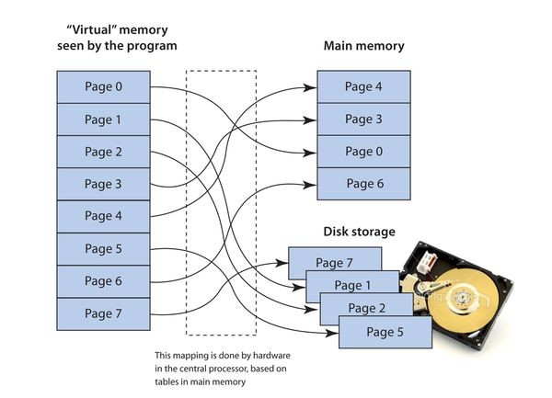
Memory management
Virtual Memory uses secondary storage to give programs the illusion that they have infinite storage
We split the process into smaller pages. Load pages into memory only when needed
Constantly swapping stuff in and out of main memory

Slide 61
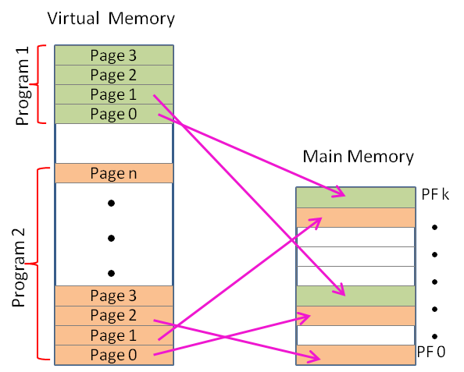
Memory management
Virtual Memory uses secondary storage to give programs the illusion that they have infinite storage
We split the process into smaller pages. Load pages into memory only when needed
A process in memory is not contiguous

Slide 62

Memory management
Virtual Memory uses secondary storage to give programs the illusion that they have infinite storage
Virtual addresses!
Physical addresses!
We split the process into smaller pages. Load pages into memory only when needed
A process in memory is not contiguous
In probe.c, we are seeing virtual addresses!

Slide 63

OS Review
Process Manager
Manages how processes are structured and how to handle many processes running at once
Interface Manager
Manages communication between apps and hardware
Memory Manager
Manages how physical memory is utilized

